Slide 1
CIS_120 Final_Program “The Trials of Daggervale”
Conner Wilkinson

Slide 2
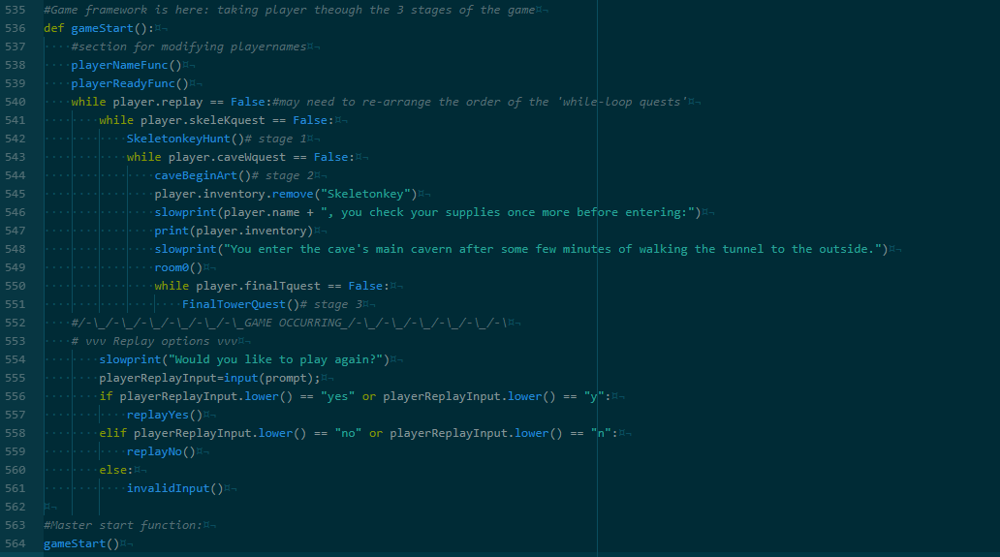
The game itself is the 3 larger games we have created over the course of Intro to Programming. It consists of 3 interlinked sub-games, in which the player gathers items required to proceed to the end of the game and win.

Slide 3
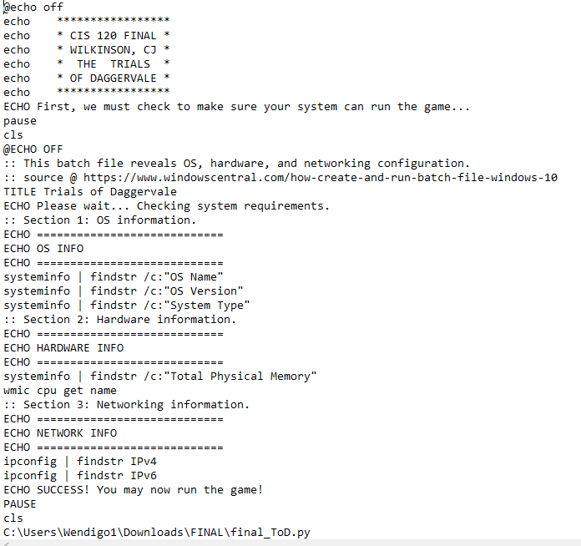
The final_ToD.py is executed via the final.bat batch file.
The .bat file reads and outputs sys info before starting the game.

Slide 4
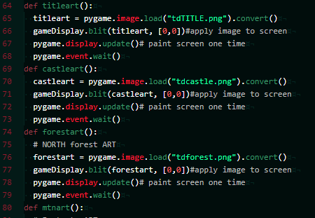
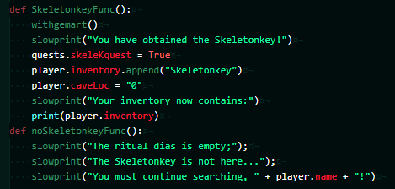
I wanted art to accompany the game as you progressed.
Majority of bugs started here.
The OS crashed the pygame window if it didn’t read enough events (it was idle for too long) ~5 sec
pygame.event.wait()

Slide 5

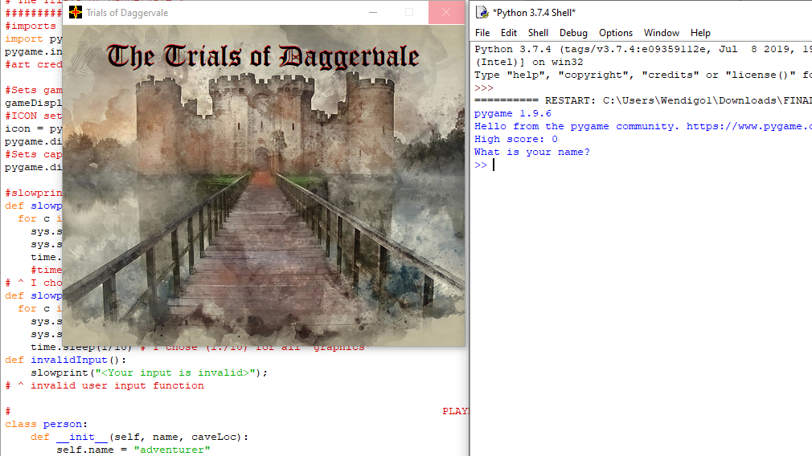

Slide 6
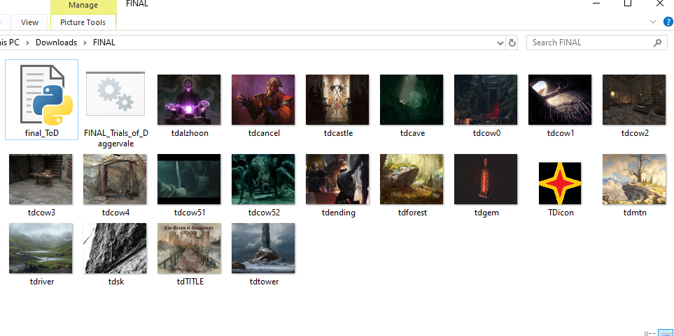
artstation.com
unsplash.com
google.com/images

